Slide 1
NFS Application Protocol
IT221 Project

Slide 2
TABLE OF CONTENTS
01
03
02
04
INTRODUCTION
VULNERABILITIES
ALTERNATIVES
PROTOCOL OPERATION

Slide 3
INTRODUCTION
NFS stands for Network File System.
Network protocol that allows any computer on the network to access the files that are stored on the server.
Makes possible to edit the files as if they were stored locally.
Reduces storage cost and security concerns

Slide 4
PROTOCOL OPERATION
A Network File System (NFS) enables remote computers to mount file systems across a network and interact with them as if they were mounted locally.
1-A simple system is used in the Network File System (NFS), where a "mount command" instructs the server to connect to multiple clients.
2- The clients will then have access to all files on the server via the appropriate platform.
3-This design allows many security protocols to function in one location, dictating
who has access to which files, making it safer to work.

Slide 5
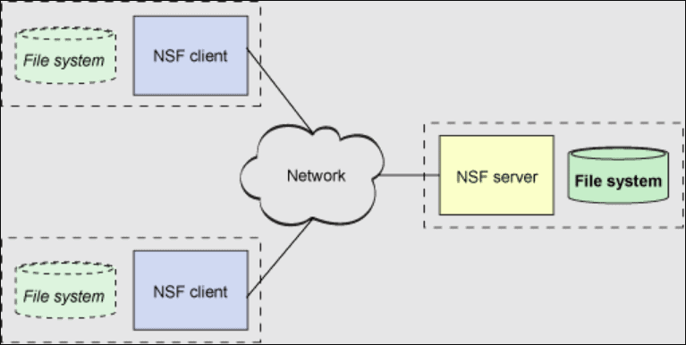
PROTOCOL OPERATION

Slide 6
PROTOCOL OPERATION
NFSv2 Network File System (NFSv2):
NFS Version 2, the first version of the NFS protocol, is the most extensively used and supported version. It communicates over an IP network using the User Datagram Protocol (UDP). The IP network enables a reliable network connection.

Slide 7
PROTOCOL OPERATION
Network File System, Version 3 (NFSv3):
The NFS Version 3 protocol, in contrast to the NFS Version 2 protocol, supports asynchronous writes and can handle files larger than 2 Gbytes. When compared to version 2, the architecture produces improved buffering. NFSv3 can also handle faults and manage larger files more efficiently.

Slide 8
PROTOCOL OPERATION
Version 4 of the Network File System (NFS) (NFSv4) :
NFSv4 is the most recent version of the Network File System protocol you can use. It can work on the internet. it is easier to run it in more places. In this NFS format, the Transmission Control Protocol (TCP) is used. TCP connections exist between an application and an IP address. It keeps track of data segments and only needs to receive missing frames in the TCP set when something needs to be sent a second time.

Slide 9
PROTOCOL OPERATION
Negotiation between Versions 2 and 3
The protocol level is negotiated as part of the commencement process since NFS servers may be serving clients who are not running NFS version 3 software. Version 3 is utilized when it can be supported by both the client and the server. Version 2 is chosen if neither the client nor the server can support any other version.
Negotiation between UDP and TCP
The transport protocol is also negotiated during initiation. The first connection-oriented transport that is accepted by the client and server is chosen by default. The first connectionless transport protocol that becomes available is utilized if this choice fails.

Slide 10
PROTOCOL OPERATION
Negotiations over file transfer size
The size of the buffers utilized for sending data between the client and the server is determined by the file transfer size. Larger transfer sizes are preferable in general. Although the NFS version 3 protocol allows for unlimited transfer sizes, as of the Solaris 2.6 release, the software bids a 32 Kbyte default buffer size. If necessary, the customer can provide a reduced transfer size at mount time, however in most cases this bid is not necessary.
With systems that make use of the NFS version 2 protocol, the transfer size is not negotiable. The maximum transfer size is set to 8 Kbytes in this case.

Slide 11
VULNERABILITIES
Like any other unprotected network protocol, NFS is vulnerable to many different types of attacks.
One of them is eavesdropping and imposter attacks: An eavesdropping attack happens when a hacker intercepts, alters or deletes data being transmitted between two devices. Data in transit between machines can be accessed through eavesdropping, also known as sniffing or snooping, which relies on insecure network interactions.
Falsified file handles cannot be distinguished from those created by the mounted daemon by an NFS server. Any file on the server that is not owned by the root can be read and modified by a client who is able to monitor the network and steal a file handle.

Slide 12
Alternatives
The following alternatives are used to overcome vulnerabilities:
SSH protocol
SSHFS protocol
AFS protocol

Slide 13
SSH protocol “ Secure Shell “
The Secure Shell (SSH) protocol is a method for safe remote login from one computer to another. Strong encryption is used to safeguard the security and integrity of communications, and it offers a number of additional alternatives for strong authentication.
It offers a safe substitute for unsafe file transfer protocols, and unprotected login protocols like Telnet and rlogin (such as FTP).

Slide 14
SSHFS “ The Secure Shell Filesystem “
Accessing remote files and directories is made simple by the Secure Shell Filesystem (SSHFS). Using an SSHFS connection, you may view, access, and edit files and folders on your A2 Hosting account.
SSHFS utilizes SSH (Secure Shell), which encrypts and secures all connections, to connect with the server.

Slide 15
AFS protocol
AFS is a distributed file system that enables client and server hosts to cooperatively share file system resources in an effective manner.
NFS cannot scale as well as the AFS. With great performance on wide-area configuration and security based on Kerberos mutual authentication, it works effectively in small and very large deployments.

Slide 16
REFERENCES
B. Callaghan, NFS illustrated. Reading, Mass.: Addison-Wesley,.
“What is NFS - Network File System (How it Works),” Cloud Infrastructure Services, Mar.12,2022.https://cloudinfrastructureservices.co.uk/what-is-nfs-network-file-system-how-it-works
“How the NFS Service Works (System Administration Guide: Resource Management and Network Services),” docs.oracle.com. https://docs.oracle.com/cd/E19683-01/806-4076/6jd6amr0j/index.html (accessed Sep. 21, 2022).
S. Sheinin, “NFS Security” Global Information Assurance Certification Paper, 2000.
Usenix Association, Uniforum (Organization, and Computer Emergency Response Team, Proceedings of the sixth annual USENIX Security Symposium : focusing on applications of cryptography : July 22-25, 1996, San Jose, California. Berkeley, Ca: The Association, 1996.
“How to use SSHFS (Secure Shell Filesystem),” www.a2hosting.com. https://www.a2hosting.com/kb/getting-started-guide/accessing-your-account/using-sshfs-secure-shell-filesystem (accessed Sep. 21, 2022).
“Alternate File Sharing Systems,” ibgwww.colorado.edu. http://ibgwww.colorado.edu/~lessem/psyc5112/usail/network/nfs/afss.html#:~:text=Alternatives%20to%20NFS%20include%20AFS%2C%20DFS%20and%20RFS (accessed Sep. 21, 2022).

